Slide 1
Welcome to
Instructions and tips for the online application process
August 2019

Slide 2
Loan Requirements
The SELF Loan requires both a borrower and a co-signer.
The borrowers starts the application process.
After the borrower applies for the loan, an e-mail is sent to the co-signer with a link and Application Reference ID required to complete the application.

Slide 3
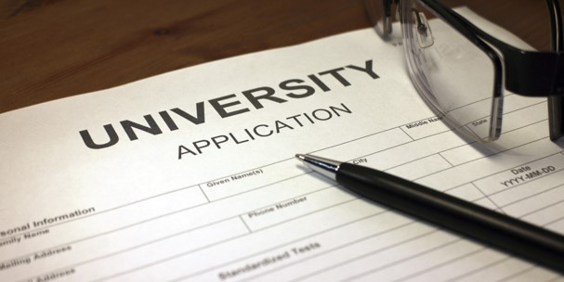
Begins the application…
Borrower

Slide 4
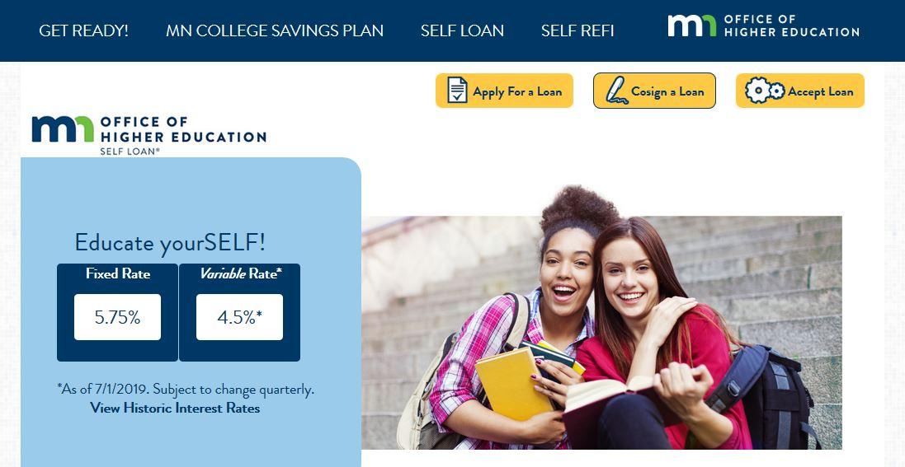
Lets begin!

Slide 5
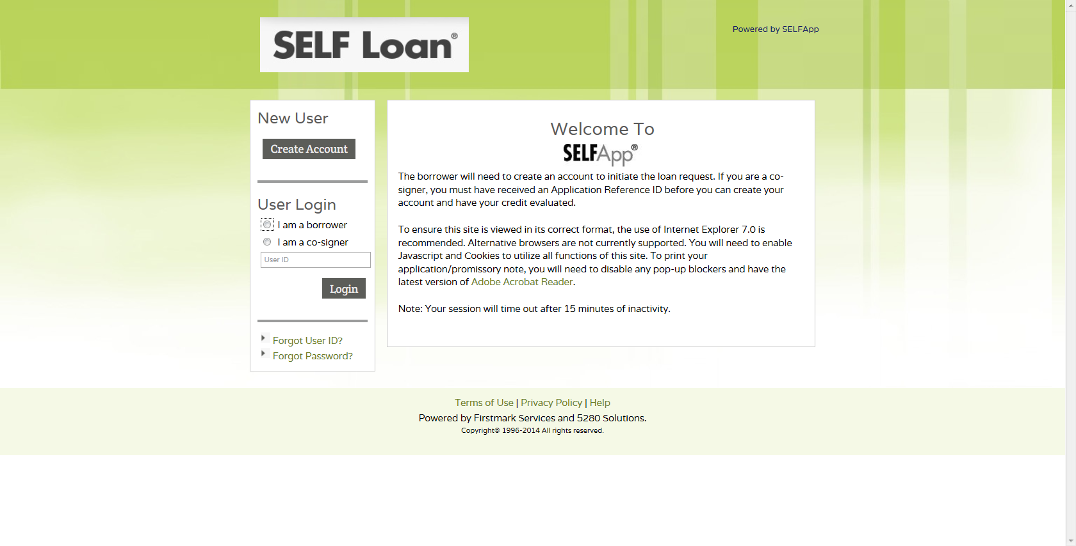
The borrower and co-signer must have their own User ID and password.
First-time borrowers start here.

Slide 6
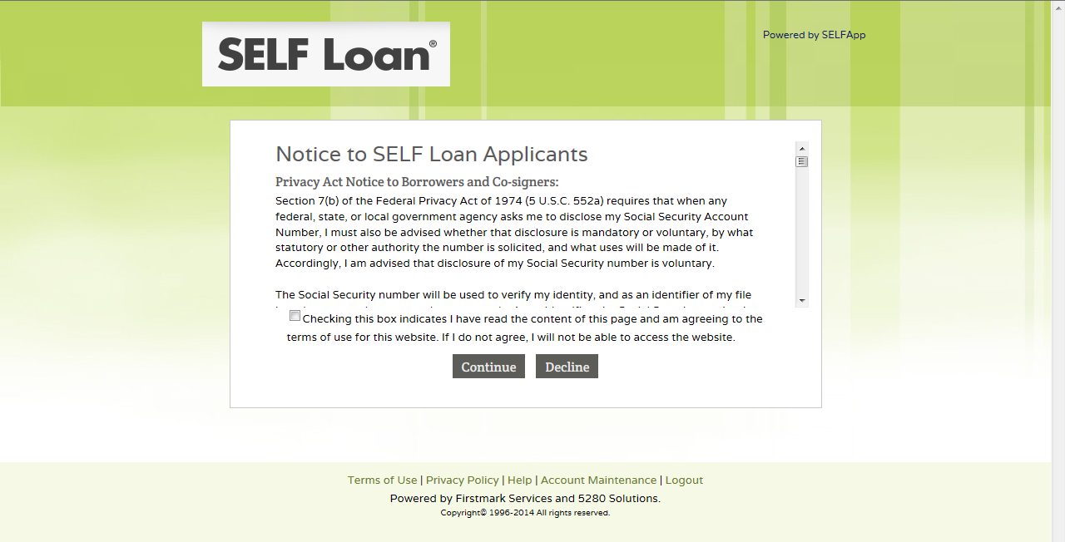
The borrower must read and agree with the terms of use agreement for the web site by checking the box and clicking ‘Continue.’

Slide 7
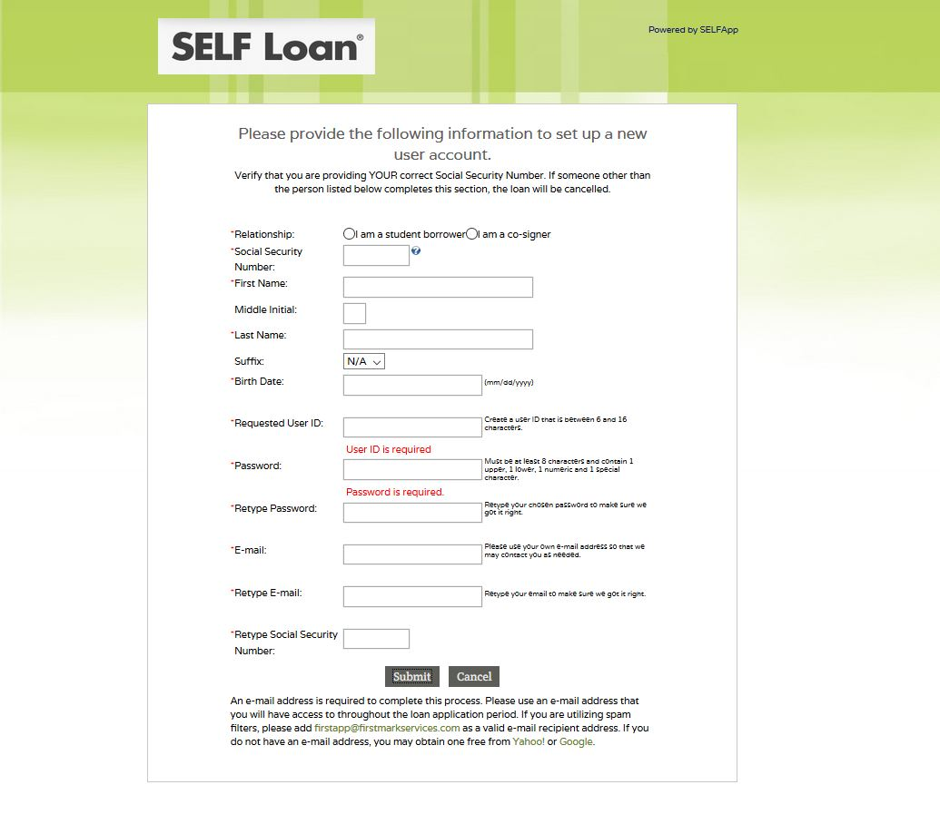
The borrower creates a new user account and clicks ‘Submit’ to continue.

Slide 8
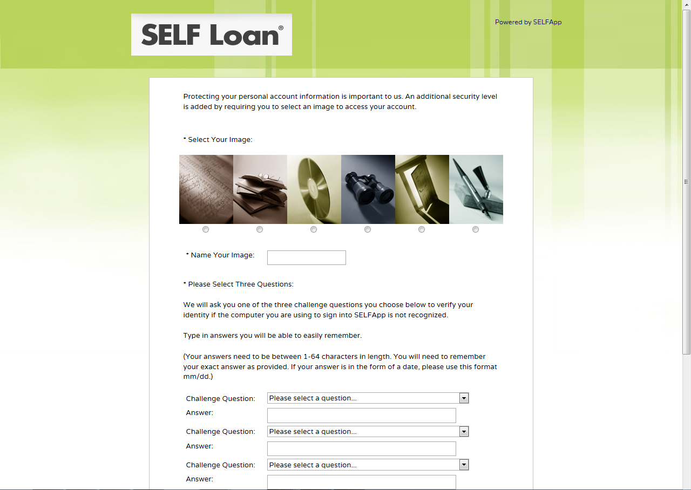
The borrower selects a security image, assigns a name to their image, and selects and answers three challenge questions. The borrower will also be asked if they want their computer to be recognized whenever they login. If they select ‘Yes,’ a secure cookie will be created upon login.

Slide 9
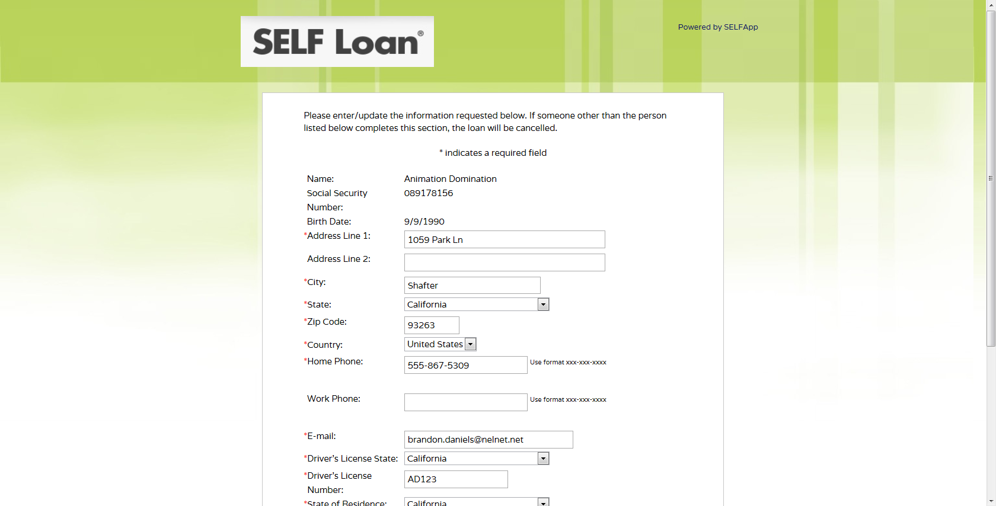
The borrower enters demographic information and clicks ‘Continue.’

Slide 10
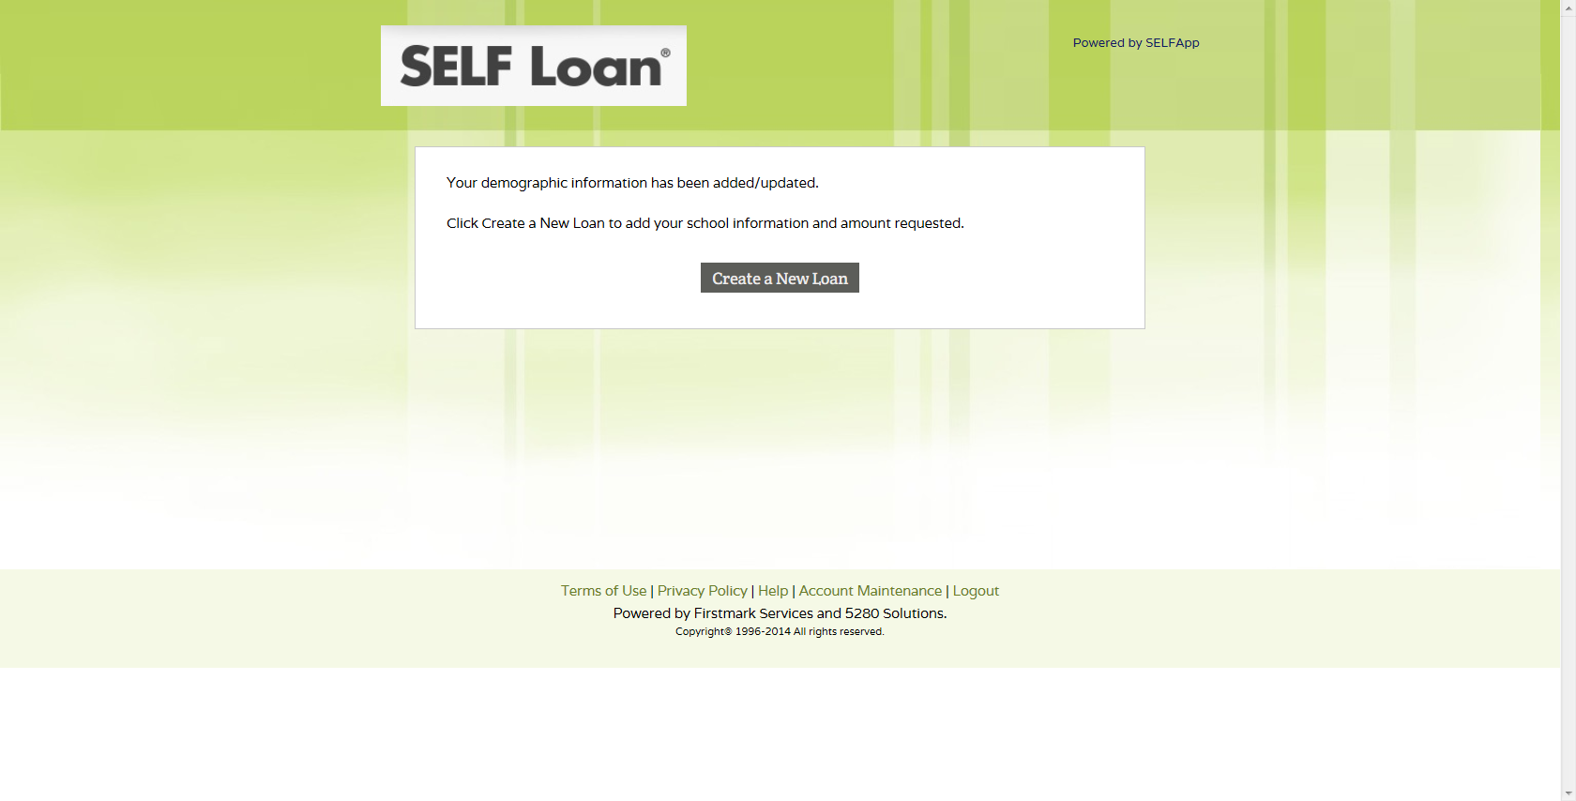
The borrower clicks ‘Create a New Loan’ to start the loan application process.

Slide 11
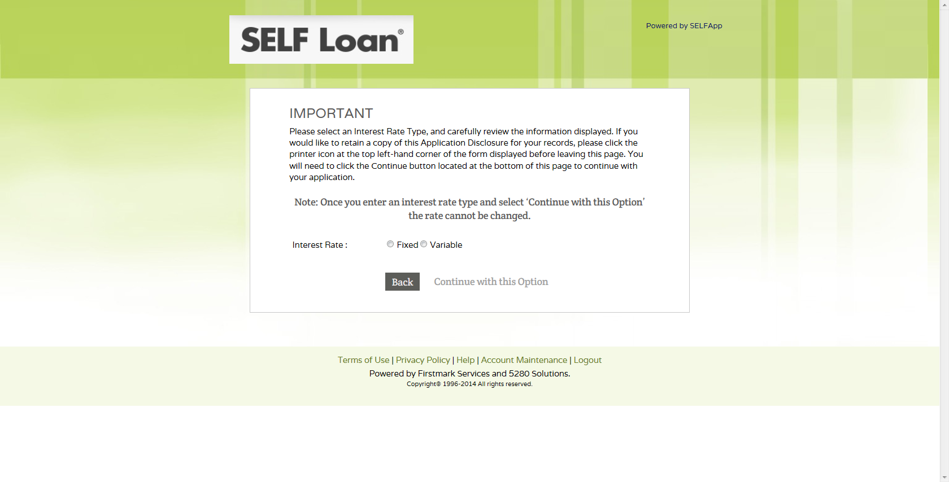
The borrower chooses either ‘Fixed’ or ‘Variable’ interest rate to review the disclosure.

Slide 12
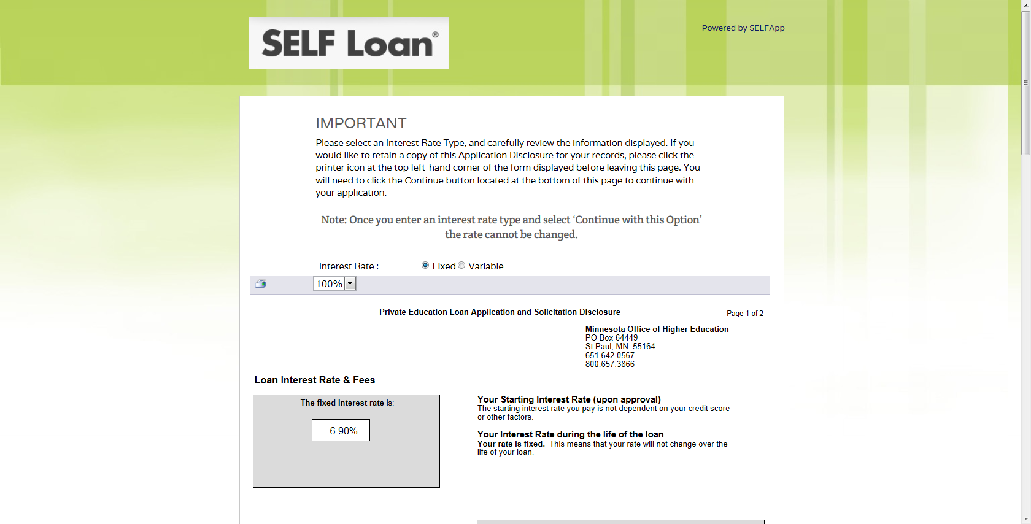
Based on the interest rate selected, the borrower will see an Application Disclosure outlining the initial terms of the loan.
This example shows the borrower selecting the ‘Fixed’ interest rate.
‘Back’ returns the borrower to the previous screen and allows a new interest rate to be selected.
By clicking ‘Continue with this Option,’ the interest rate selection is locked in and cannot be changed.

Slide 13
Depending upon the school, the borrower will see only one of the term options listed below.
Option #1: The borrower enters the loan period begin and end dates.
Option #2: The borrower selects term.
Option #3: The borrower selects term. The loan period begin and end dates under Option #3 have been determined by the school.

Slide 14
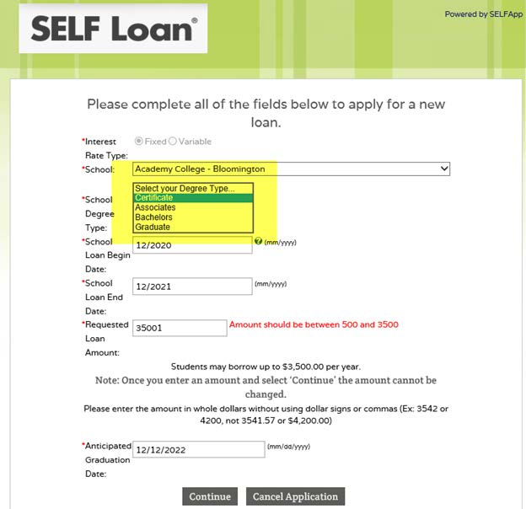
School Term Option #1:
The borrower selects School, Degree Type, and enters School Loan Begin Date, School Loan End Date (the difference between the two dates cannot exceed 12 months), Requested Loan Amount and Anticipated Graduation Date and clicks ‘Continue.’

Slide 15
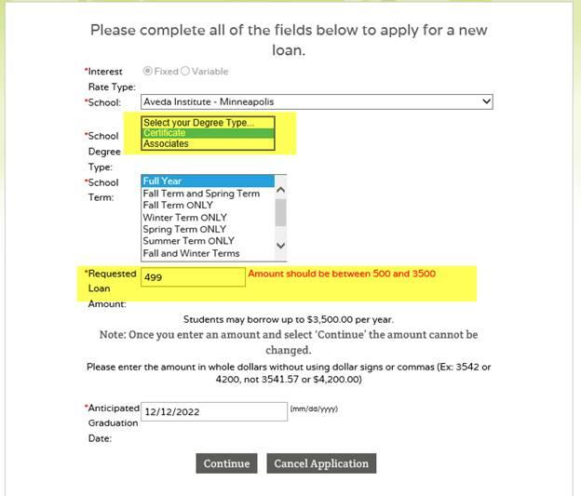
School Term Option #2:
The borrower selects School, Degree Type, and School Term, then enters Requested Loan Amount and Anticipated Graduation Date and clicks ‘Continue.’

Slide 16
School Term Option #3:
The borrower selects School, Degree Type, and School Term, then enters Requested Loan Amount and Anticipated Graduation Date and clicks ‘Continue.’

Slide 17
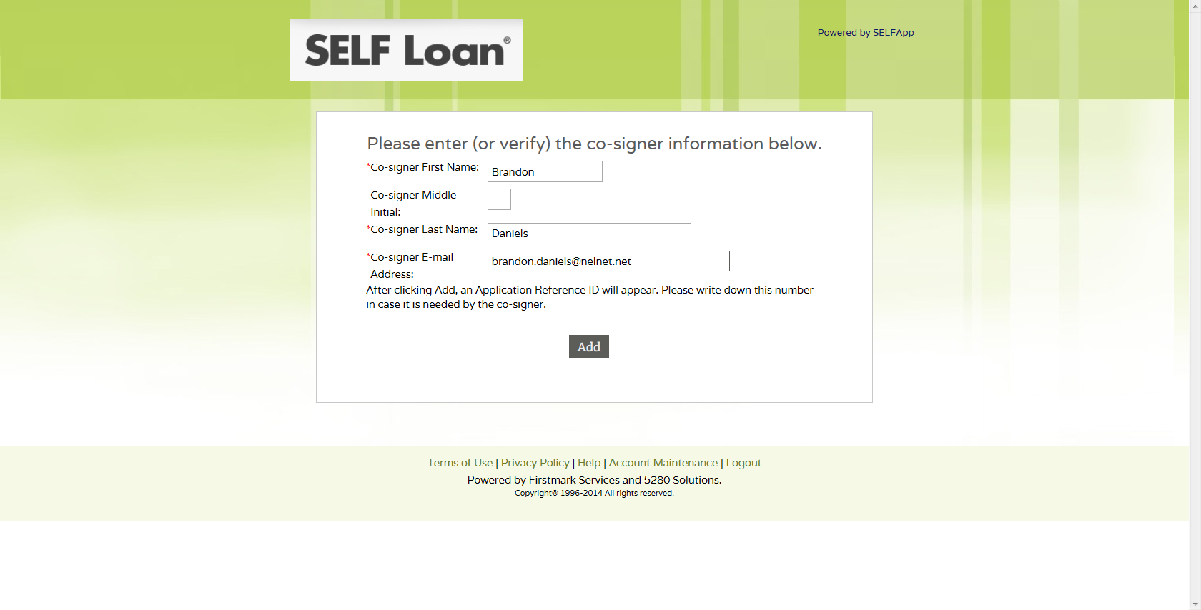
The borrower enters their co-signer’s information.
This e-mail address is where the link and Application Reference ID will be sent informing the co-signer to complete their process.

Slide 18
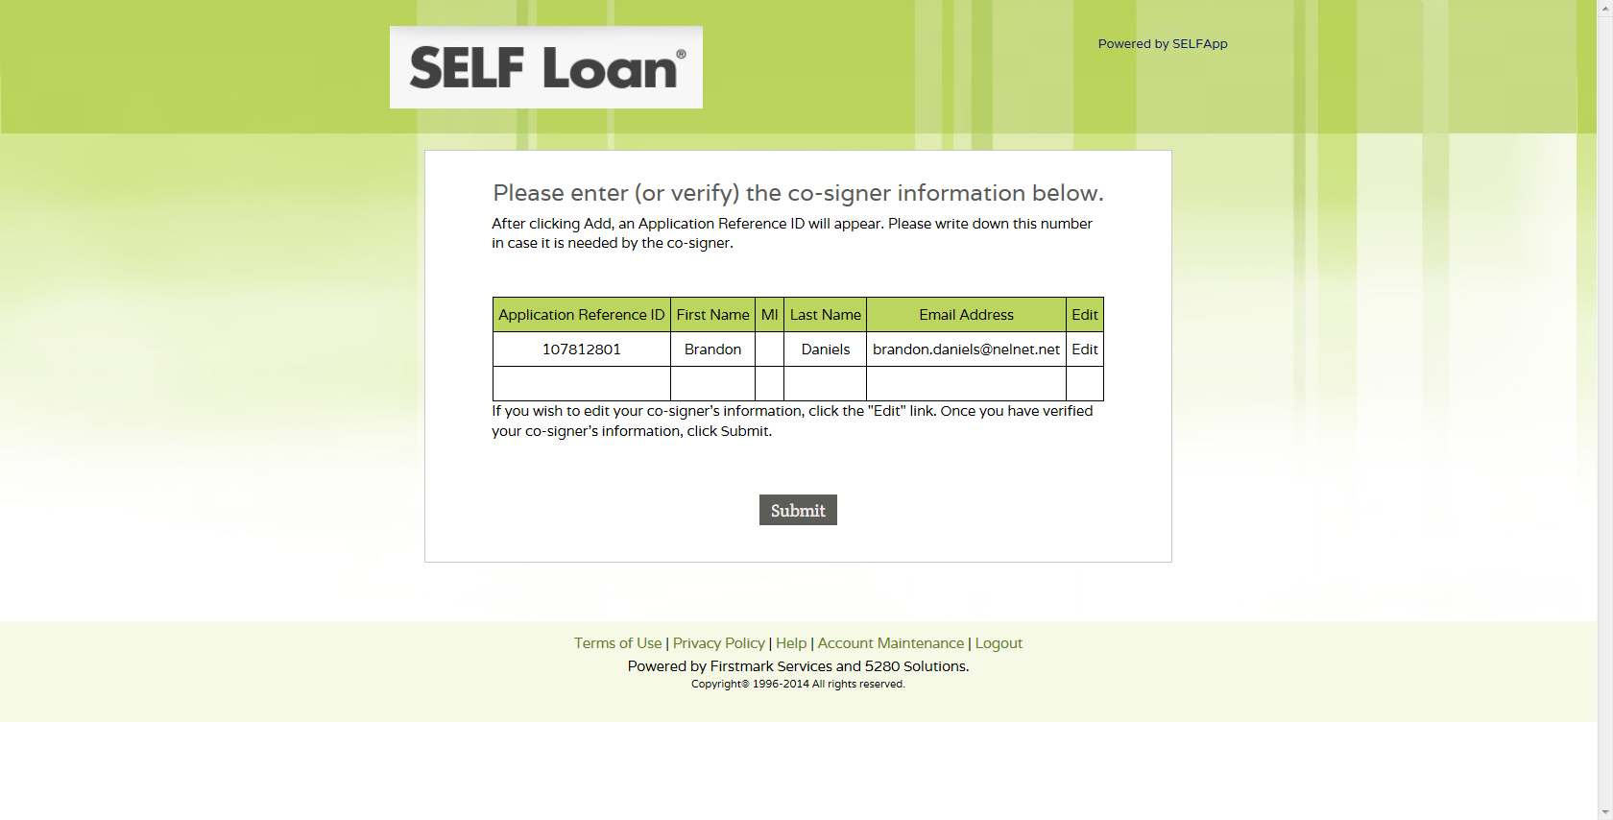
The borrower is advised to write down the Application Reference ID in case the co-signer does not receive the e-mail.
The e-mail may be routed to a Junk or Spam folder.

Slide 19
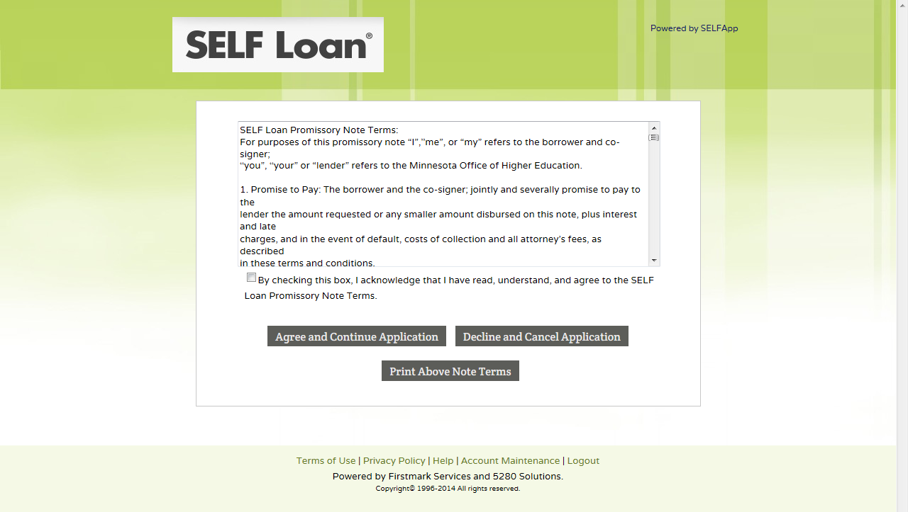
In order to proceed, the borrower must read through the SELF Loan Promissory Note Terms, check this box and click ‘Agree and Continue Application.’

Slide 20
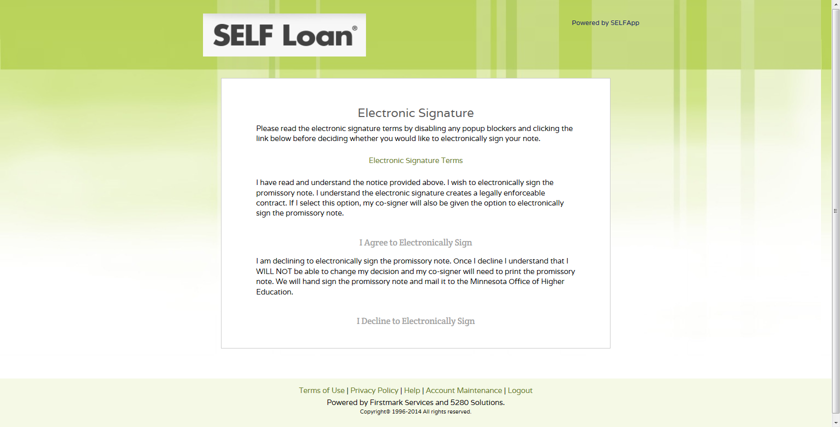
The borrower must click ‘Electronic Signature Terms’ before they can agree or decline to electronically sign the promissory note.

Slide 21
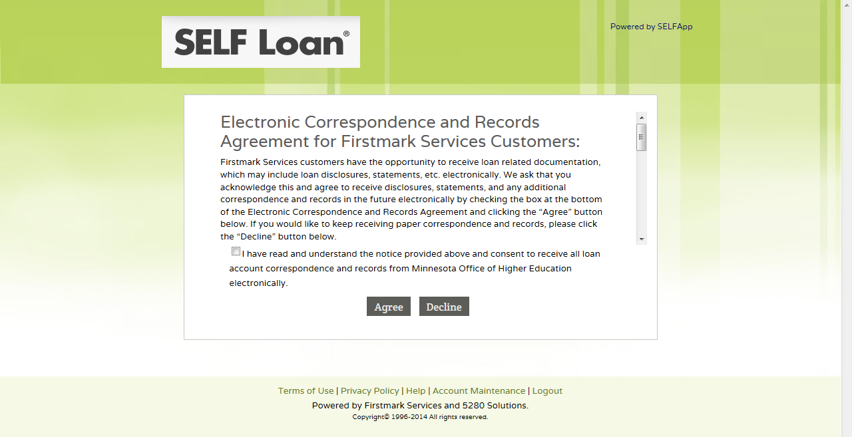
If the borrower checks the box and selects ‘Agree,’ they will receive communication (including billing statements) via e-mail.
If the borrower selects ‘Decline,’ they will receive all communication via mail.

Slide 22
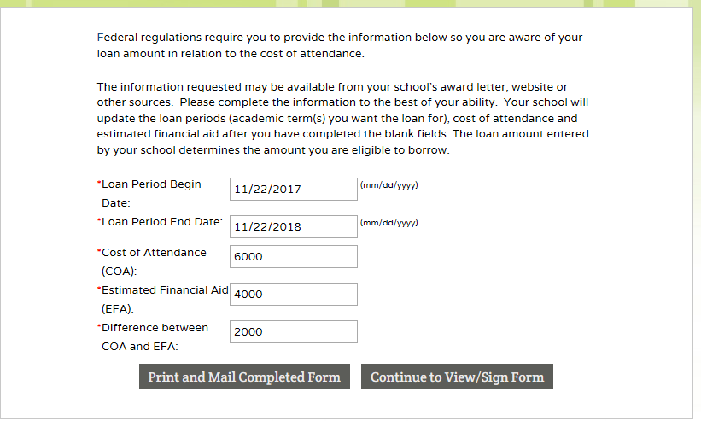
The borrower must select one of the following options: ‘Print and Mail Form,’ or ‘Continue to View/Sign Form’

Slide 23
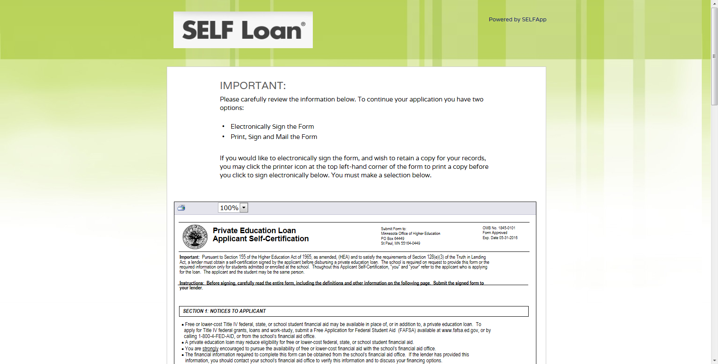
This form will be pre-populated with the information from the previous screen and the borrower’s demographic information. The borrower must check the box and choose ‘Electronically Sign Form and Continue’ or ‘I will Print and Mail the Form.’

Slide 24
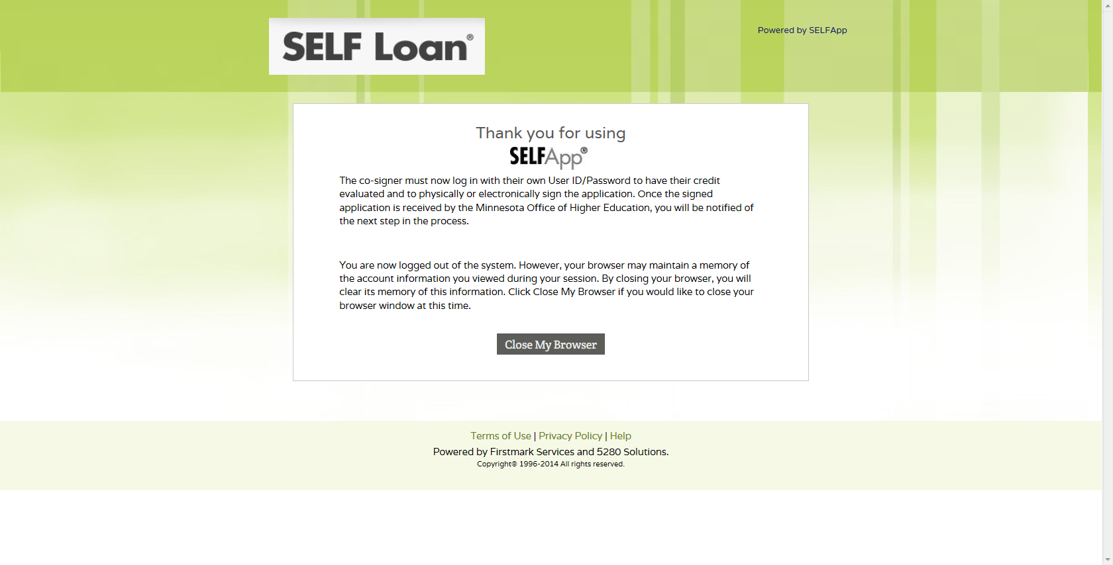
The borrower has completed their portion of the application process.

Slide 25
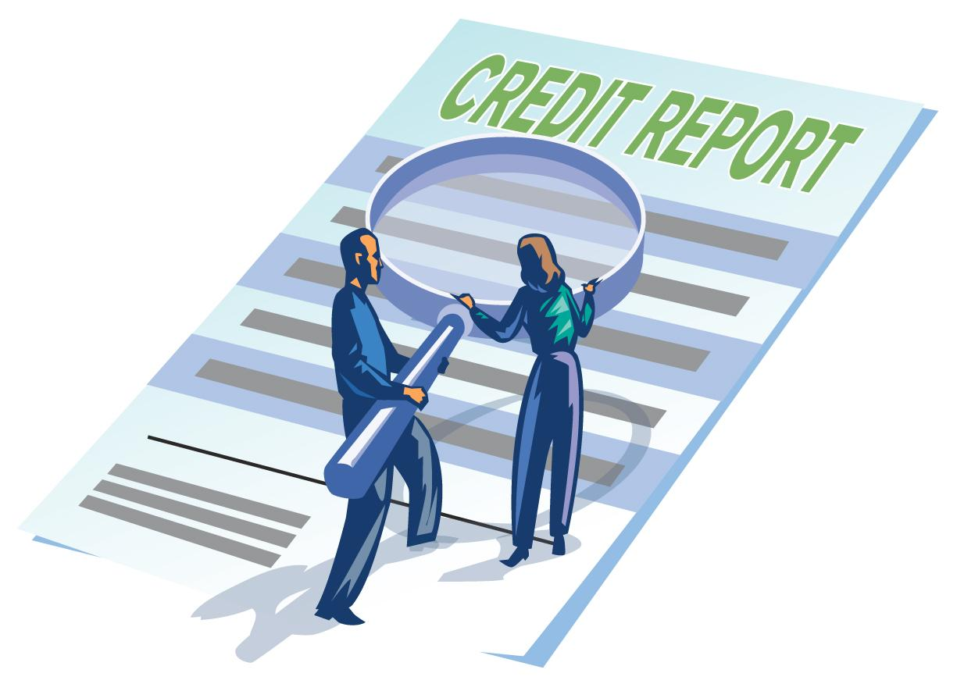
The Co-Signer Completes Credit Check
The co-signer will receive an e-mail with the Application Reference ID and login link to complete their portion of the application. (If the co-signer does not receive an e-mail, they should check their “Junk” or “Spam” mail or contact the borrower, since the Application Reference ID was provided to the borrower during the application process.)

Slide 26
The co-signer will receive an e-mail from SELFApp® with the Application Reference ID. They can then login and complete their part of the application process.

Slide 27
The borrower and co-signer CANNOT have the same User ID and password.
First-time co-signers start here.

Slide 28
The co-signer must read and agree with the terms of use agreement for the web site by checking the box and clicking ‘Continue.’

Slide 29
The co-signer creates a new user account and clicks ‘Submit’ to continue.

Slide 30
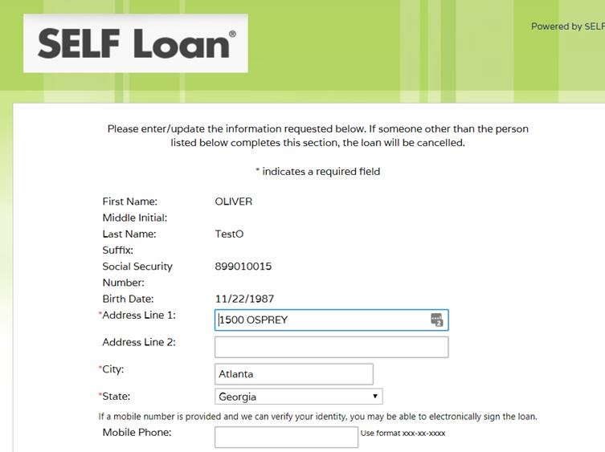
By entering a mobile phone a co-signer may have the option to electronically sign using a PIN sent to your mobile phone.

Slide 31
The co-signer selects a security image, assigns a name to their image, and selects and answers three challenge questions. The co-signer will also be asked if they want their computer to be recognized whenever they login. If they select ‘Yes,’ a secure cookie will be created upon login.

Slide 32
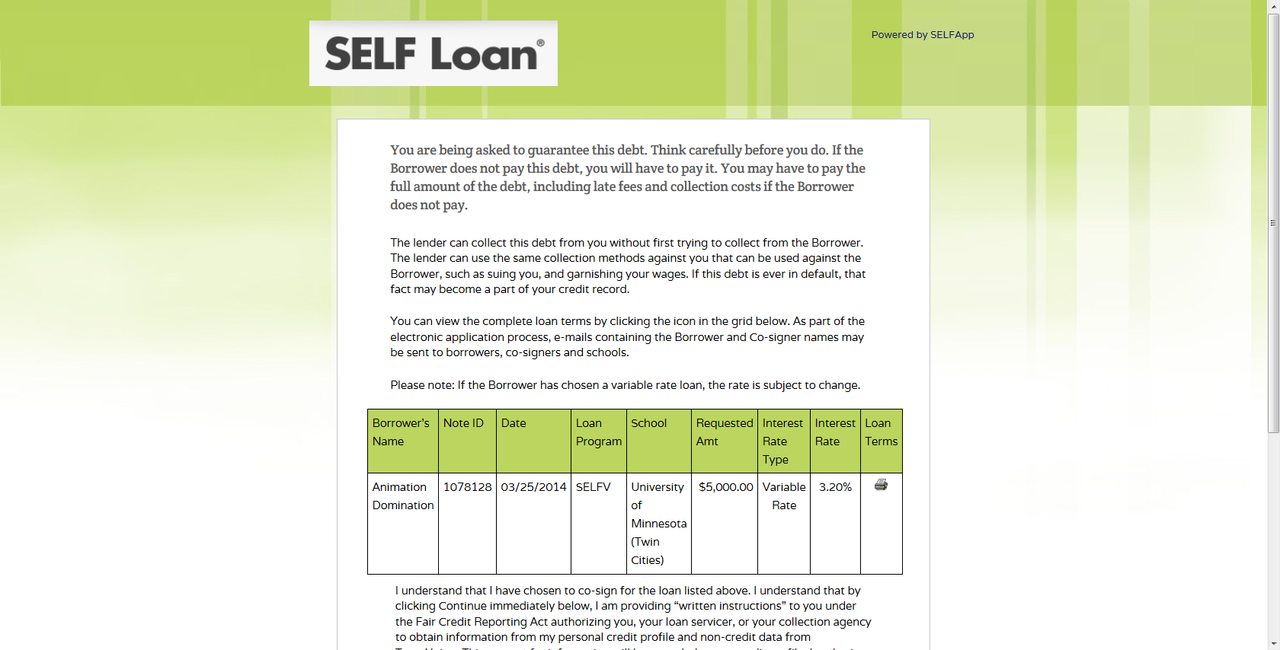
If the co-signer selects ‘I do not wish to co-sign for this loan,’ the borrower will be sent an e-mail notification. The borrower would then need to select another co-signer.

Slide 33
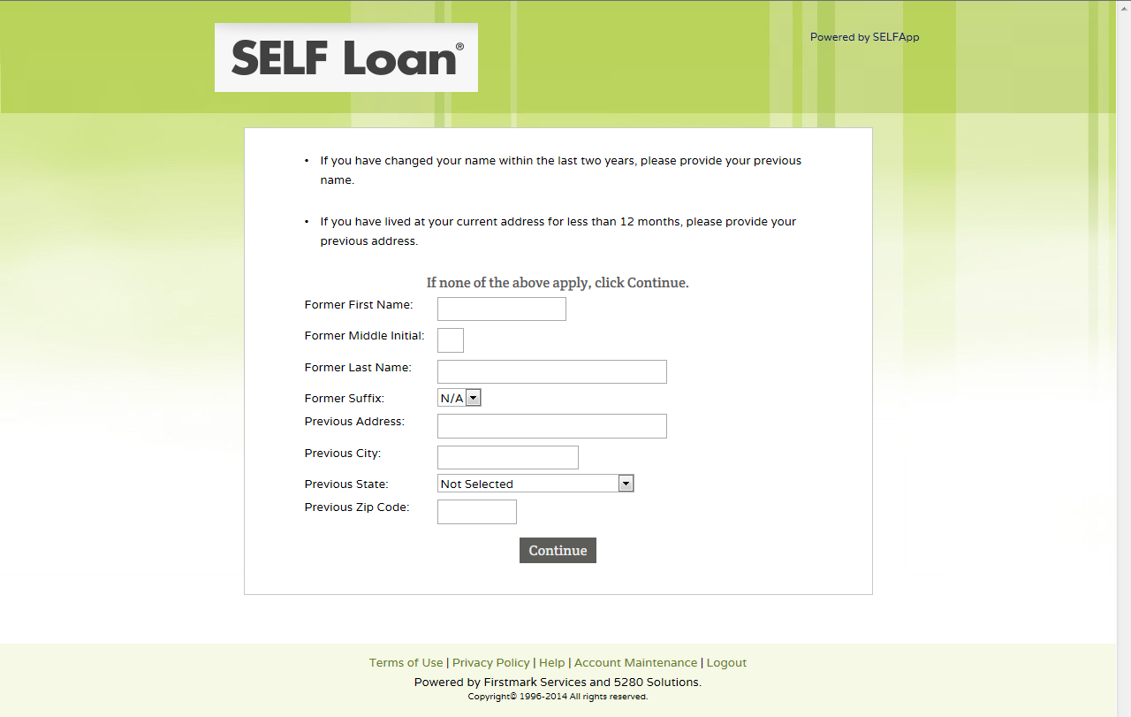
The co-signer should complete this screen only if their information has changed, as indicated in the first paragraph.

Slide 34
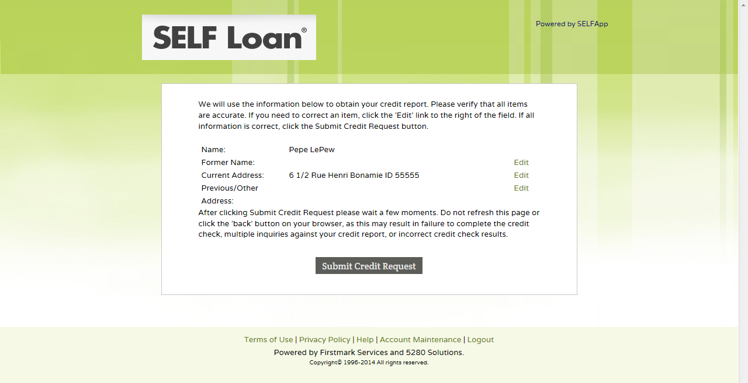
The co-signer should verify that this information is accurate and ‘Edit’ if not correct.

Slide 35
The co-signer must click ‘Electronic Signature Terms’ before they can agree or decline to electronically sign the promissory note.

Slide 36
If the co-signer checks the box and selects ‘Agree,’ they will receive communication (including billing statements) via e-mail.
If the co-signer selects ‘Decline,’ they will receive all communication via mail.

Slide 37
The co-signer can here select to electronically sign using a PIN sent to their mobile phone (if entered in their demographic page) or answering questions based on demographic and credit information. For security reasons there are limitations on the number of attempts and times they can electronically sign within 30 days.

Slide 38
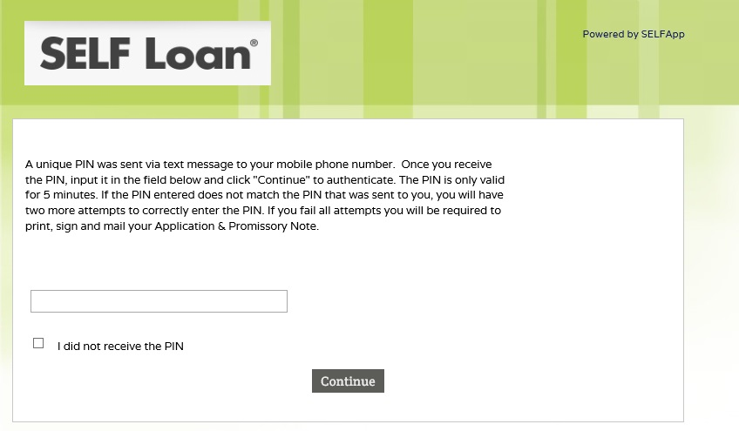
If the co-signer selects mobile phone and the credit bureau is able to verify the mobile number is registered to the co-signer they will be sent a PIN to their phone. They will need to enter the PIN here to electronically sign.

Slide 39
This is an example of a successful PIN e-signature.

Slide 40
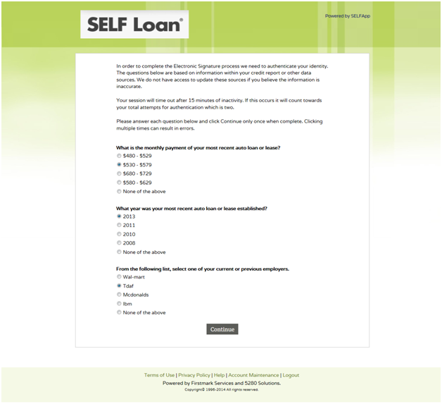
If the co-signer selects “Questions” instead of “PIN” to electronically sign they will be given a series of questions based on demographic and credit information.
These questions will vary.

Slide 41
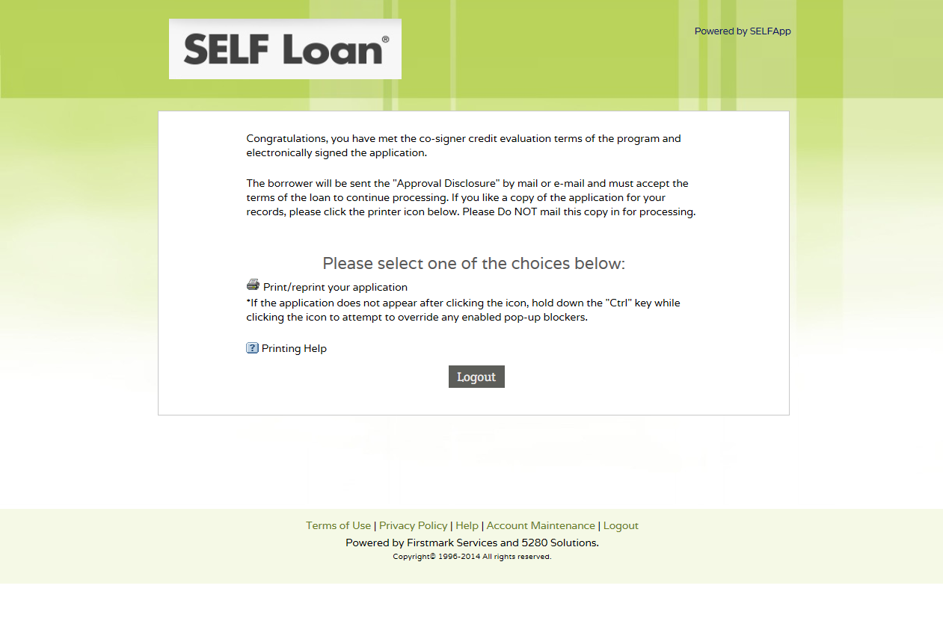
The co-signer has answered the questions correctly, electronically signed and completed the application process.
The borrower will be notified to return to the web site, login and accept the Approval Disclosure.

Slide 42
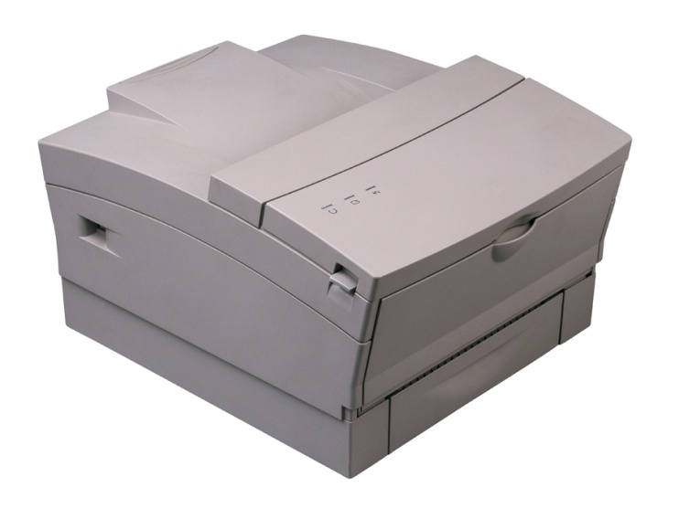
Borrower Declines to E-sign
Printing the Application
If the borrower declined to sign electronically, the electronic signature option is automatically removed for the co-signer. The application would need to be printed and both the borrower and co-signer would need to hand sign the printed copy.

Slide 43
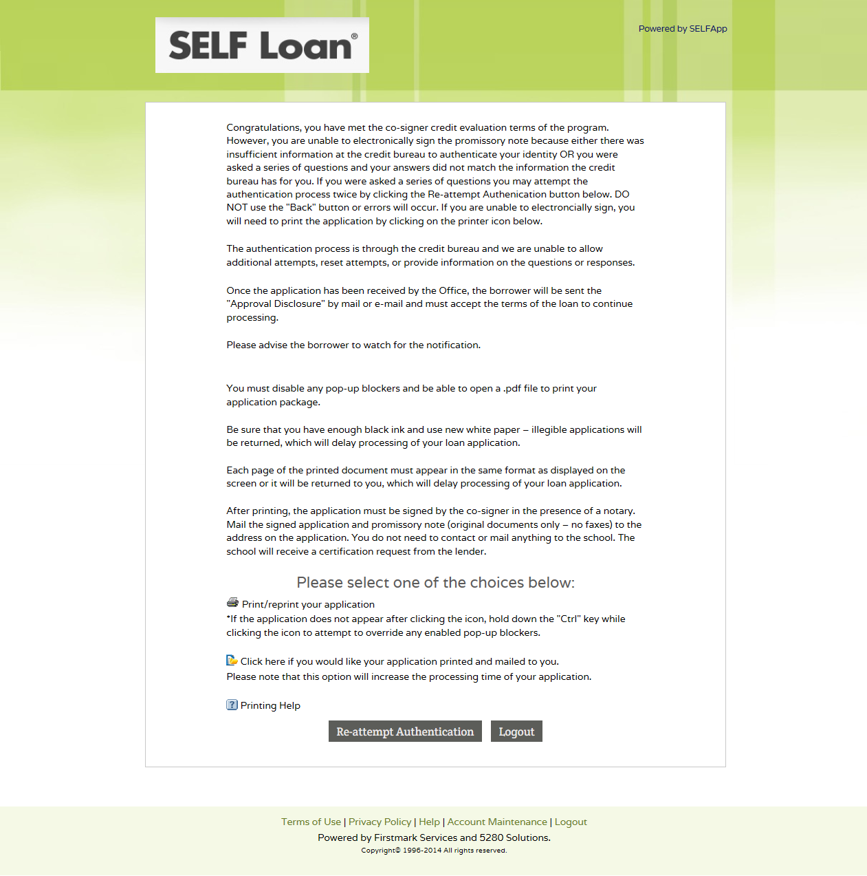
If the co-signer was NOT able to electronically sign the application, they will be directed to this page. They will be required to print the application for signature(s).

Slide 44
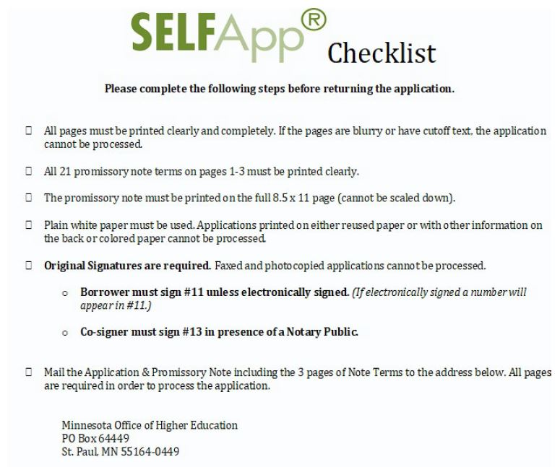
The next two screens are samples of the application.
(The application may require the borrower’s signature if the borrower declined to electronically sign, see next screen.)
*Pages 1 (the Application and Promissory Note) and pages 1-3 (the SELF Loan Promissory Note Terms) behind the checklist must be mailed in together or it will delay processing of the application.

Slide 45
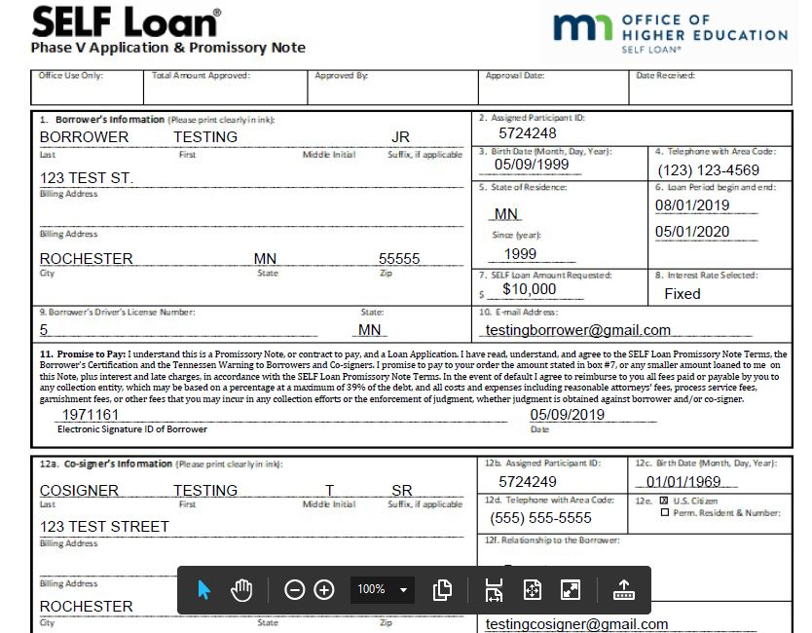
If the borrower electronically signed, there will be a signature ID here along with the date it was signed.
If the co-signer is able to electronically sign, the application would have their signature ID along with the date it was signed in their section.
If both parties e-sign, nothing needs to be mailed to our office.

Slide 46
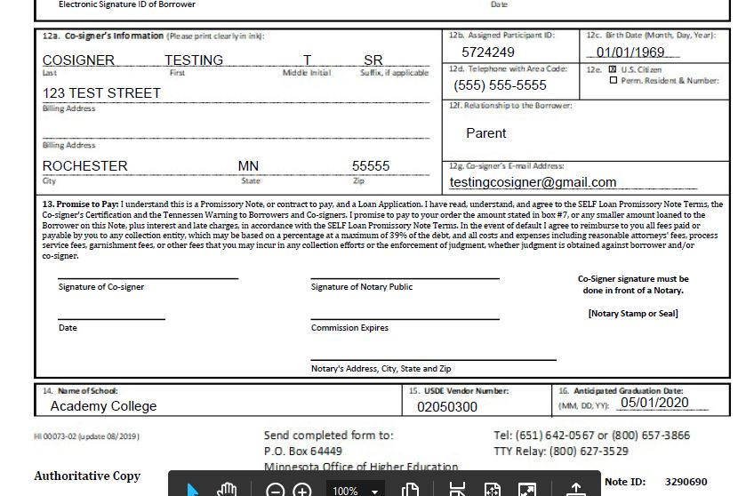
If the borrower declined to electronically sign, they must hand sign here.
If the borrower declines to e-sign the co-signer will not have the option and must hand sign.
- OR -
If the co-signer was NOT able to pass the verification process in order to electronically sign, they must sign here.
Their signature MUST be notarized.

Slide 47
The Borrower
Accepts Approval Disclosure
After the co-signer has passed the credit check the borrower will receive an e-mail to log in to SELFApp to accept the Approval Disclosure.
Borrowers not signed up for electronic correspondence will receive the Approval Disclosure in the mail with instructions to accept.

Slide 48
If the borrower has opted in for E-Correspondence, they will receive the e-mail below to accept the Approval Disclosure. If they opted out of E-Correspondence they will receive the Approval Disclosure by mail with instructions similar to below on how to accept the terms via the SELF Loan webpage seen on the next screen.
The borrower has a maximum of 30 calendar days to accept the terms of the new loan.
Action Needed: Your Loan Application
mark@gmail.com
Dear Mike Scott: Your SELF loan application has been received and further action is required from you. In order to continue the application process, you will need to:
Log in to your online account Link (If you did not apply for your loan online, you may not have a User ID and password. Click on New User to create one.)
Select the loan in process, 'Pending Acceptance'
Review the disclosure outlining the terms of the loan
Electronically accept the terms of the loan
Note: Your application will be cancelled if no action is taken. Sincerely, Firstmark Services This is an automated e-mail message, please do not reply.

Slide 49
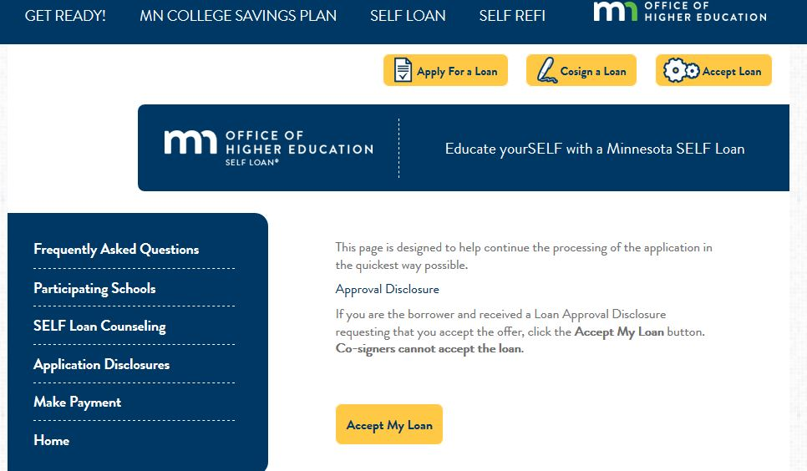
Clicking ‘Accept Loan’ will bring the borrower to the selection page.
Clicking ‘Accept My Loan’ will bring the borrower to a page to electronically or manually accept the terms.

Slide 50
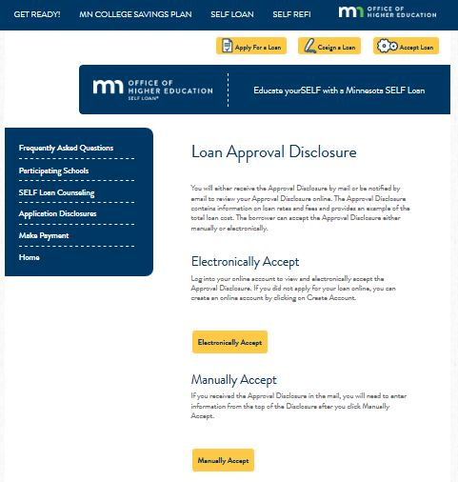
Clicking ‘Electronically Accept’ will bring the borrower to the main log in screen. Log in and select the most recent loan to accept the terms electronically. (This is shown on the next slide.)
Clicking ‘Manually Accept’ will bring the borrower to a form that they will enter their Parti ID, Note ID, first and last name and e-mail address and select either ‘Accept Loan’ or ‘Decline Loan.’

Slide 51
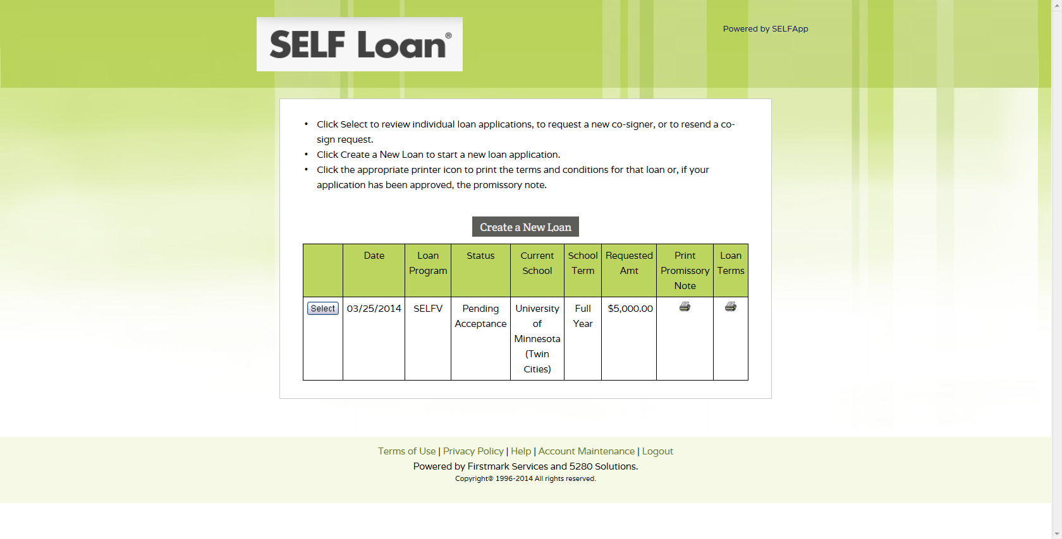
The borrower returns to SELFApp to login and accept the Approval Disclosure.
The loan must be in Pending Acceptance status for the borrower to view the Approval Disclosure.

Slide 52
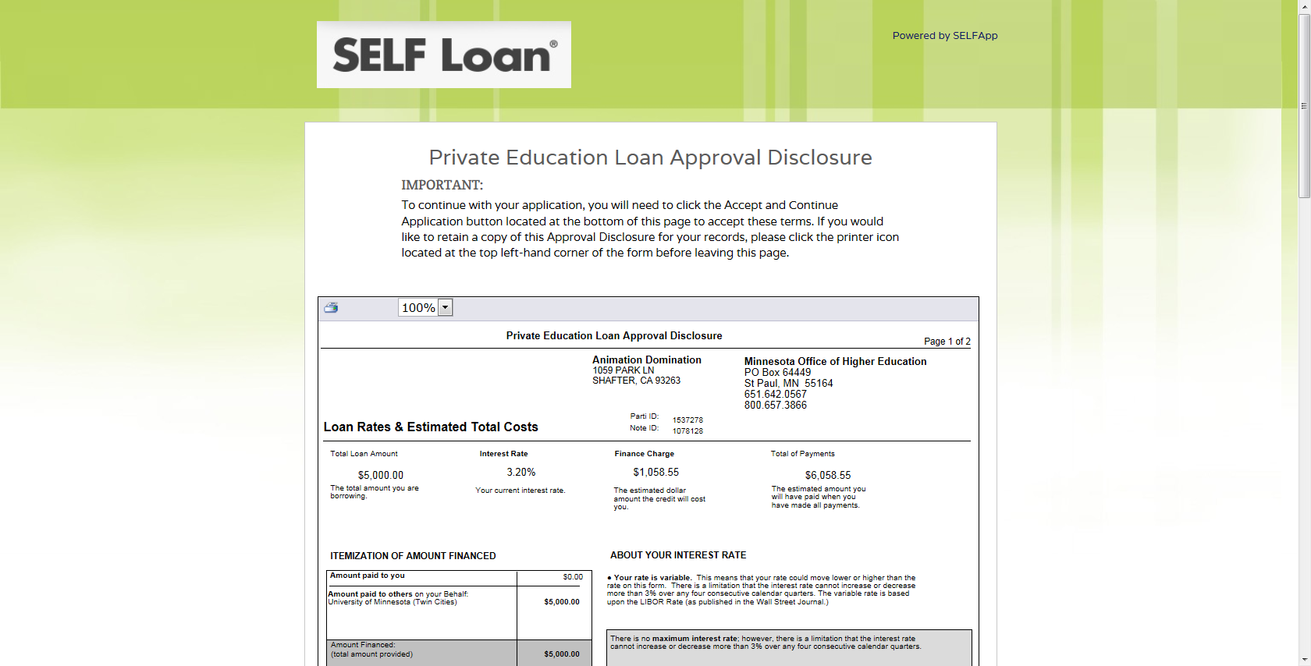
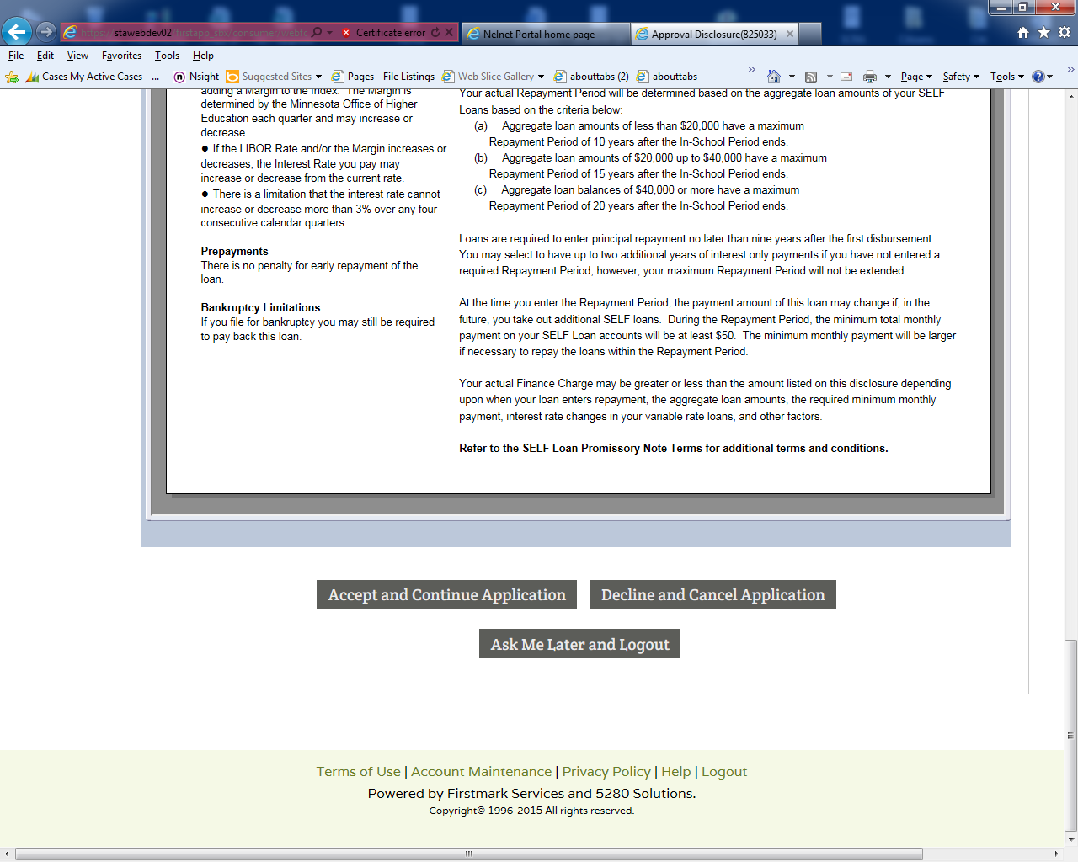
The Approval Disclosure outlines the terms of the loan.
By clicking ‘Accept and Continue Application,’ the borrower is accepting the loan.

Slide 53
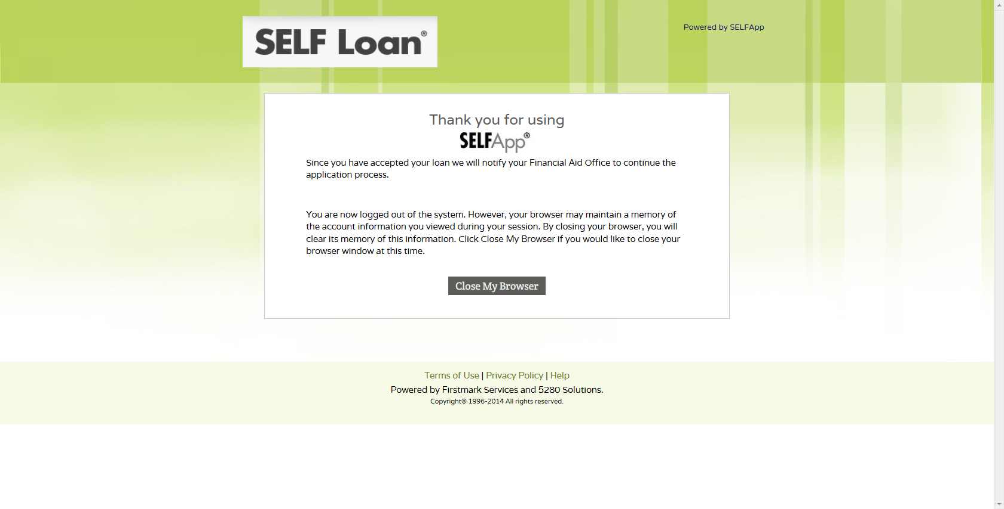
If the Applicant Self-Certification form has already been completed, the borrower is done. A Final Disclosure will be sent when the loan is approved.

Slide 54
Final Steps…
The school certifies the loan.
OHE approves the loan.
The borrower receives the Final Disclosure (no action is needed).

Slide 55
If the borrower opted in for E-Correspondence, they will receive an e-mail to login and view the Final Disclosure. If they opted out of E-Correspondence they will receive the Final Disclosure by mail.
The borrower has 3 business days to call and cancel the loan.
Your loan application is approved
mark@gmail.com
Dear Mark Miller:
Congratulations! Your student loan application has been approved. Please log in to your online account to review your Final Disclosure which outlines your rights as a borrower and the terms of your loan.
Sincerely,
Firstmark Services

Slide 56
To view the Final Disclosure, the borrower will return to SELFApp and login.
If the borrower is not signed up for electronic correspondence, the Final Disclosure will be mailed.

Slide 57
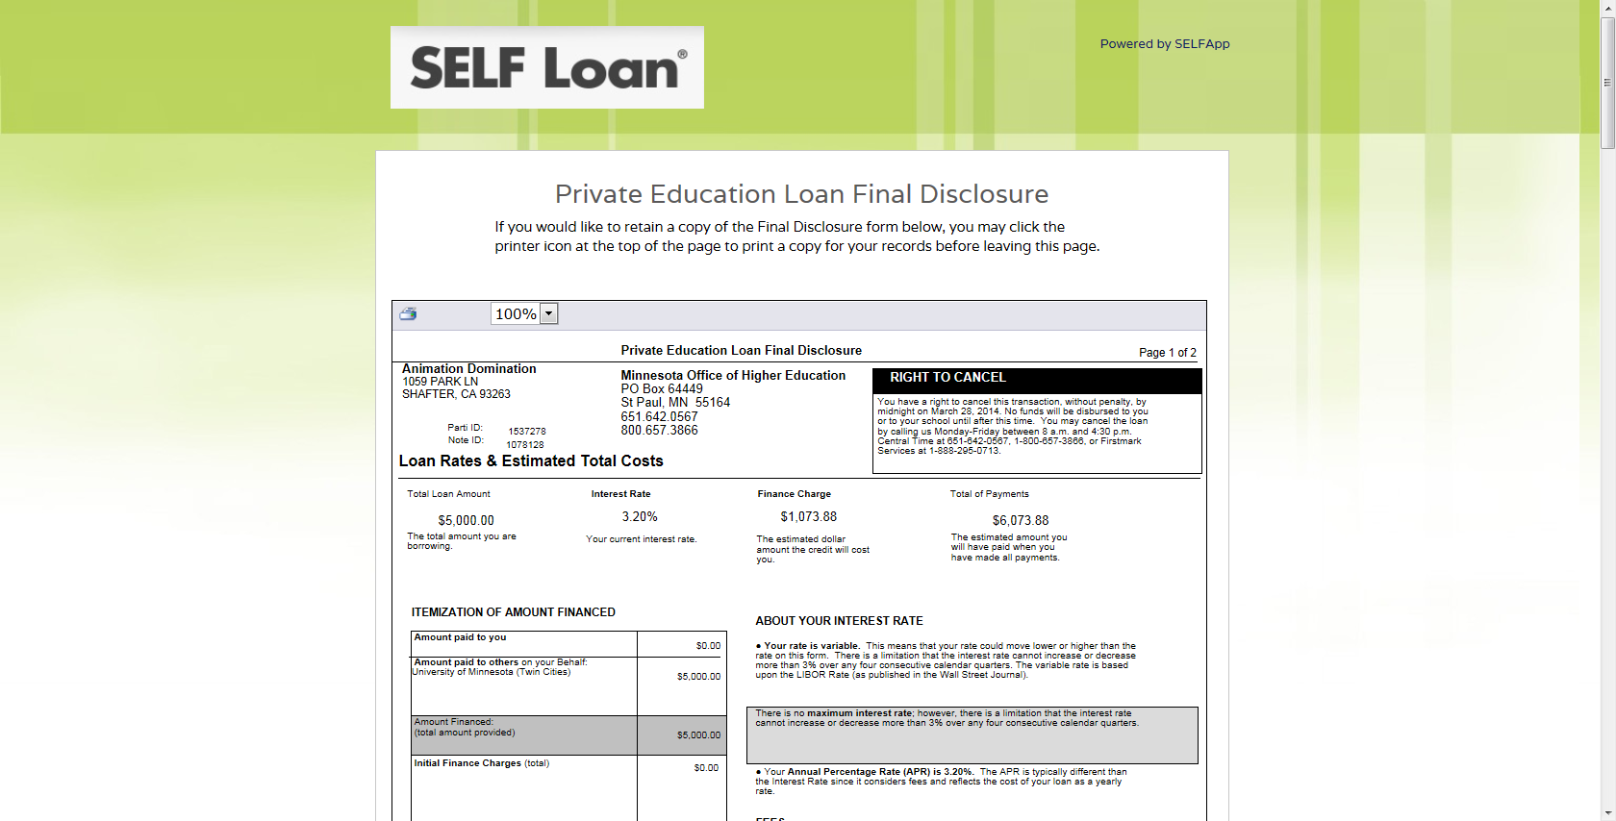
The borrower does NOT need to take any action regarding the Final Disclosure. They have 3 business days to call in and cancel the loan.

Slide 58
Approved loans
Once the final approval happens the Final Disclosure will be sent to the student via method chosen. The disclosure will list the amount approved and disbursement dates of the loan.
The borrower will see this screen after acknowledging their Final Disclosure on the prior screen.

Slide 59
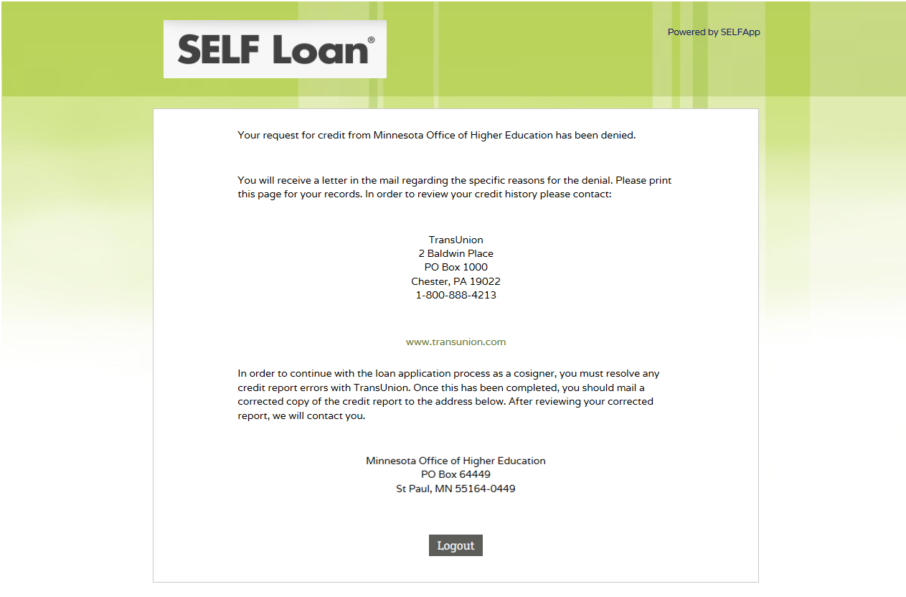
Co-signer Denial Reasons
Negative credit items on co-signer’s credit.
Unable to locate credit records.
If the borrower would like to use a new co-signer, they will need to apply for a new loan with a different co-signer.

Slide 60
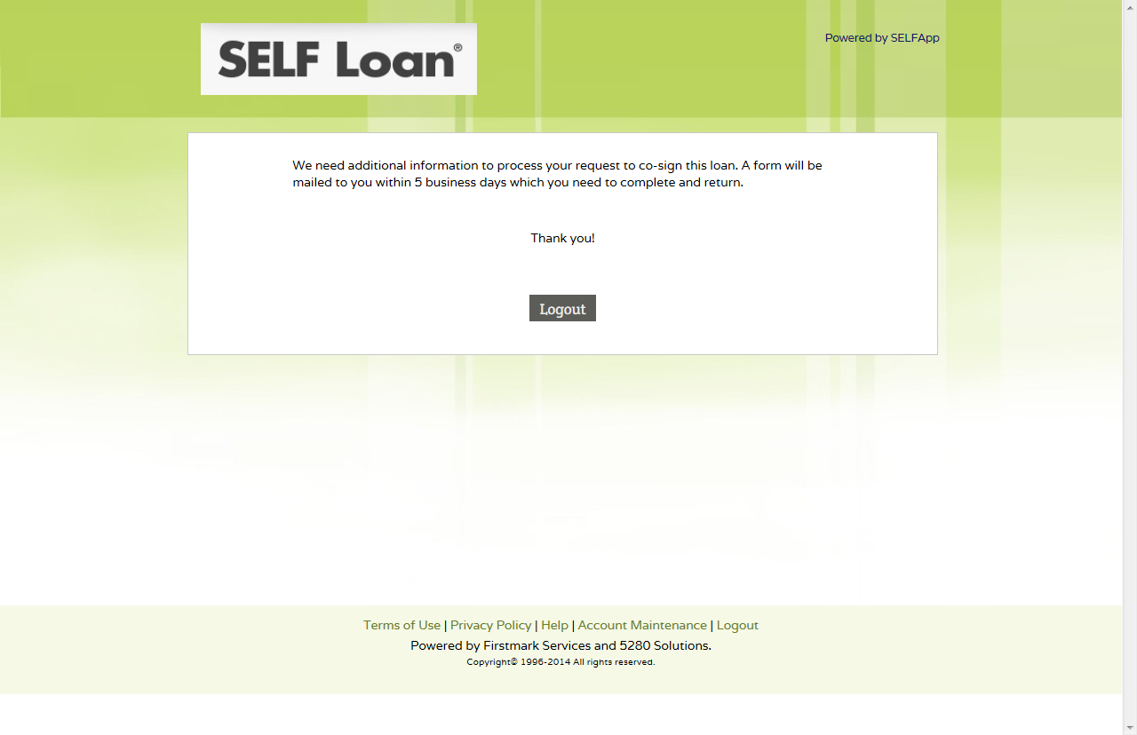
Delayed Credit Decision Reasons
If there is a flag on co-signer’s credit we will reach out prior to credit approval for authorization.
Application could NOT be approved because credit report was flagged for Identity Theft or SSN did not match.

Slide 61
Thank you for using

